Slide 1

Prototyping & Improved Wells Fargo Mobile App
Josh Zimmerman-Gibson

Slide 2
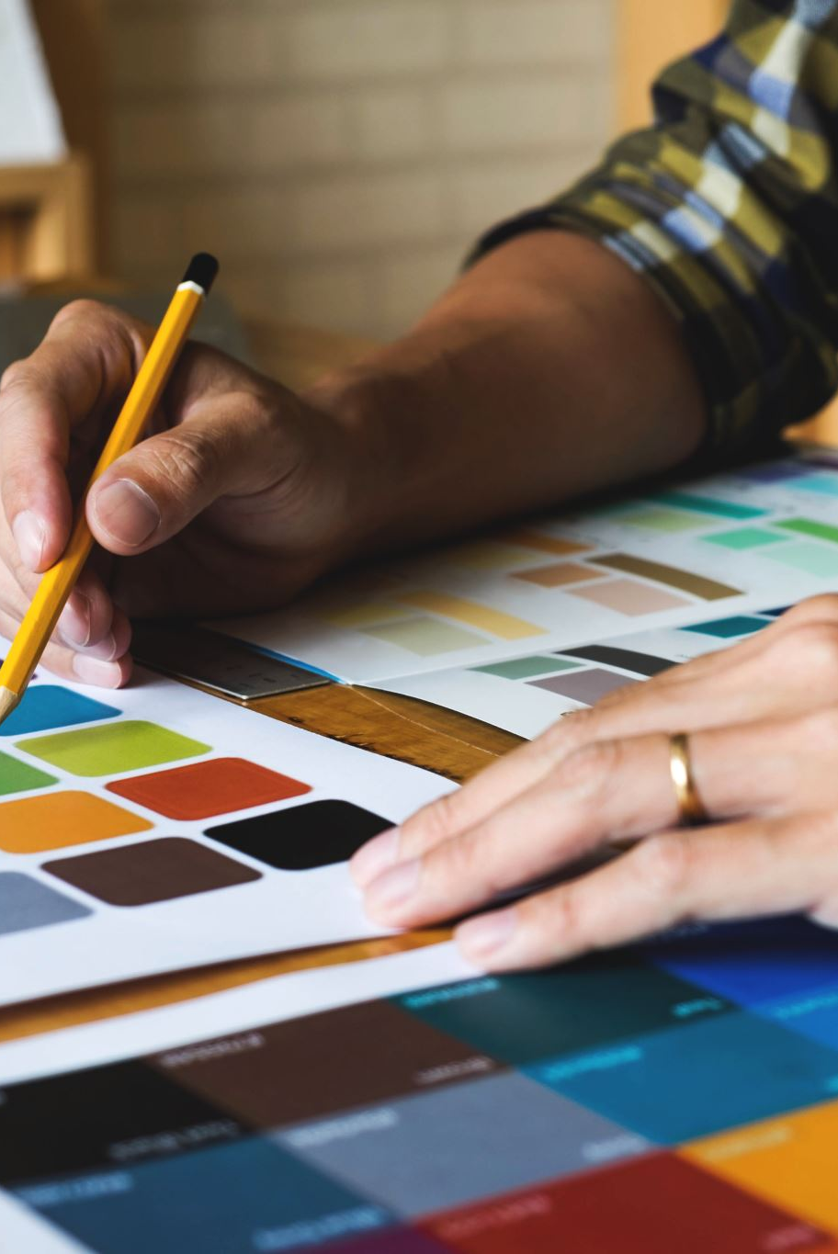
What is Prototyping?
• Prototyping is the process of creating early models of a product to test ideas.
• It helps identify design flaws, gather feedback, and improve functionality before full development.

Slide 3

Industries Using Prototyping
• Automotive: digital models, crash simulations, 3D printing
• Consumer Tech: hardware mockups, software prototypes
• Software Development: wireframes, interactive mockups, beta versions

Slide 4

Product Concept
Improved Wells Fargo Mobile App
• Goals:
- Better navigation
- Personalization
- Budgeting tools
- Accessibility improvements

Slide 5

Prototyping the App
• Low-fidelity sketches
• Mid-fidelity wireframes
• High-fidelity interactive prototype
• Functional beta version

Slide 6

Creative Design Strategies
• Empathy mapping
• Brainstorming (How Might We)
• Competitive analysis
• User personas
• Rapid iteration

Slide 7

Conclusion
• Prototyping is essential for refining product ideas and reducing risk.
• Redesigning the Wells Fargo app improves user experience, personalization, and accessibility.

